Slide 1
Project Presentation Tips
Notes:
No Code
No Apologies
Everyone must present
Don’t read your presentation to me
Know what isn’t in-scope
Things i should understand by the end of the presentation
Why you chose your topic
What data you used to investigate
Why that data makes sense to use
What your general findings were

Slide 2
Things to Avoid

Slide 3
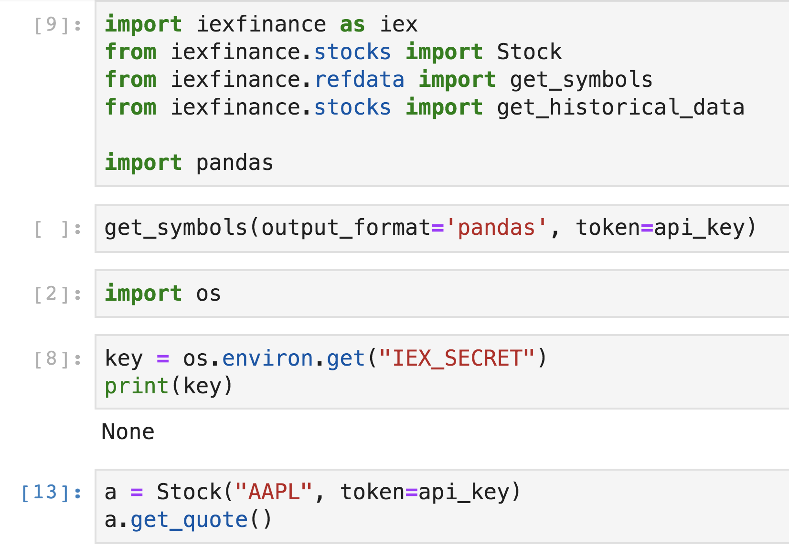
Code
I can’t read your code and listen to you at the same time.

Slide 4
Tabular Data
 | A | B | Total
Red | 22 | 34 | 56
Blue | 22 | 9 | 21
Total | 24 | 43 | 67
There is a math error here.
If i’m reading your data in a table, I’m not listening to the presentation.

Slide 5
Tabular Data
That does not, however, mean to not use tables at all. Use them only when they assist in clarifying a point and don’t detract from the presentation.

Slide 6
Color and Emphasis
 | A | B | Total
Red | 22 | 34 | 56
Blue | 22 | 9 | 21
Total | 24 | 43 | 67
Color and emphasis direct your audience to specific places.
They see what you want and go back to listening.

Slide 7
Color and Emphasis
 | A | B | Total
Red | 22 | 34 | 56
Blue | 22 | 9 | 21
Total | 24 | 43 | 67
Color and emphasis direct your audience to specific places.
They see what you want and go back to listening.

Slide 8
Color and Emphasis
 | A | B | Total
Red | 22 | 34 | 56
Blue | 22 | 9 | 21
Total | 24 | 43 | 67
Too much color and emphasis is distracting.

Slide 9
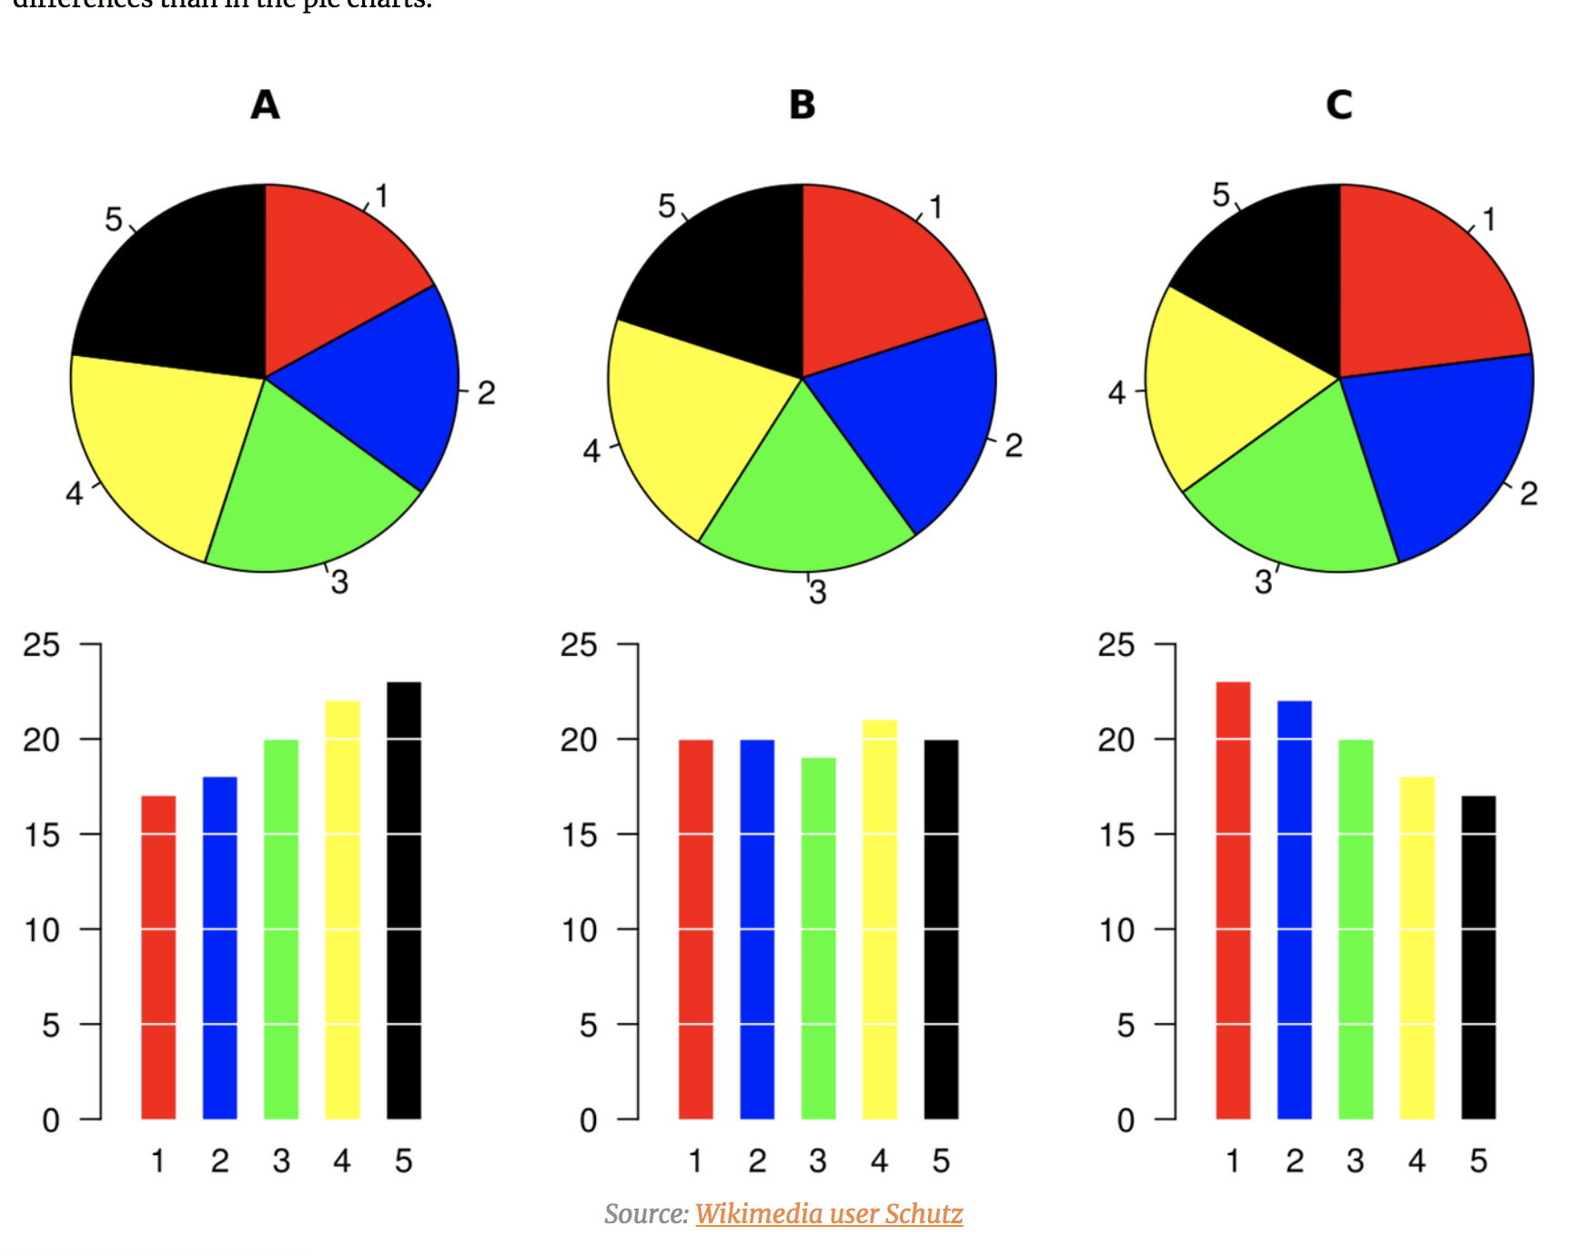
Pie Charts (except sometimes)
An updated post on pies
http://www.storytellingwithdata.com/blog/2017/1/10/an-updated-post-on-pies
F**k it, let’s use pie charts
https://policyviz.com/2018/01/11/fk-it-lets-use-pie-charts/
When Pie Charts Are Okay (Seriously): Guidelines for Using Pie and Donut Charts
https://depictdatastudio.com/when-pie-charts-are-okay-seriously-guidelines-for-using-pie-and-donut-charts/

Slide 10
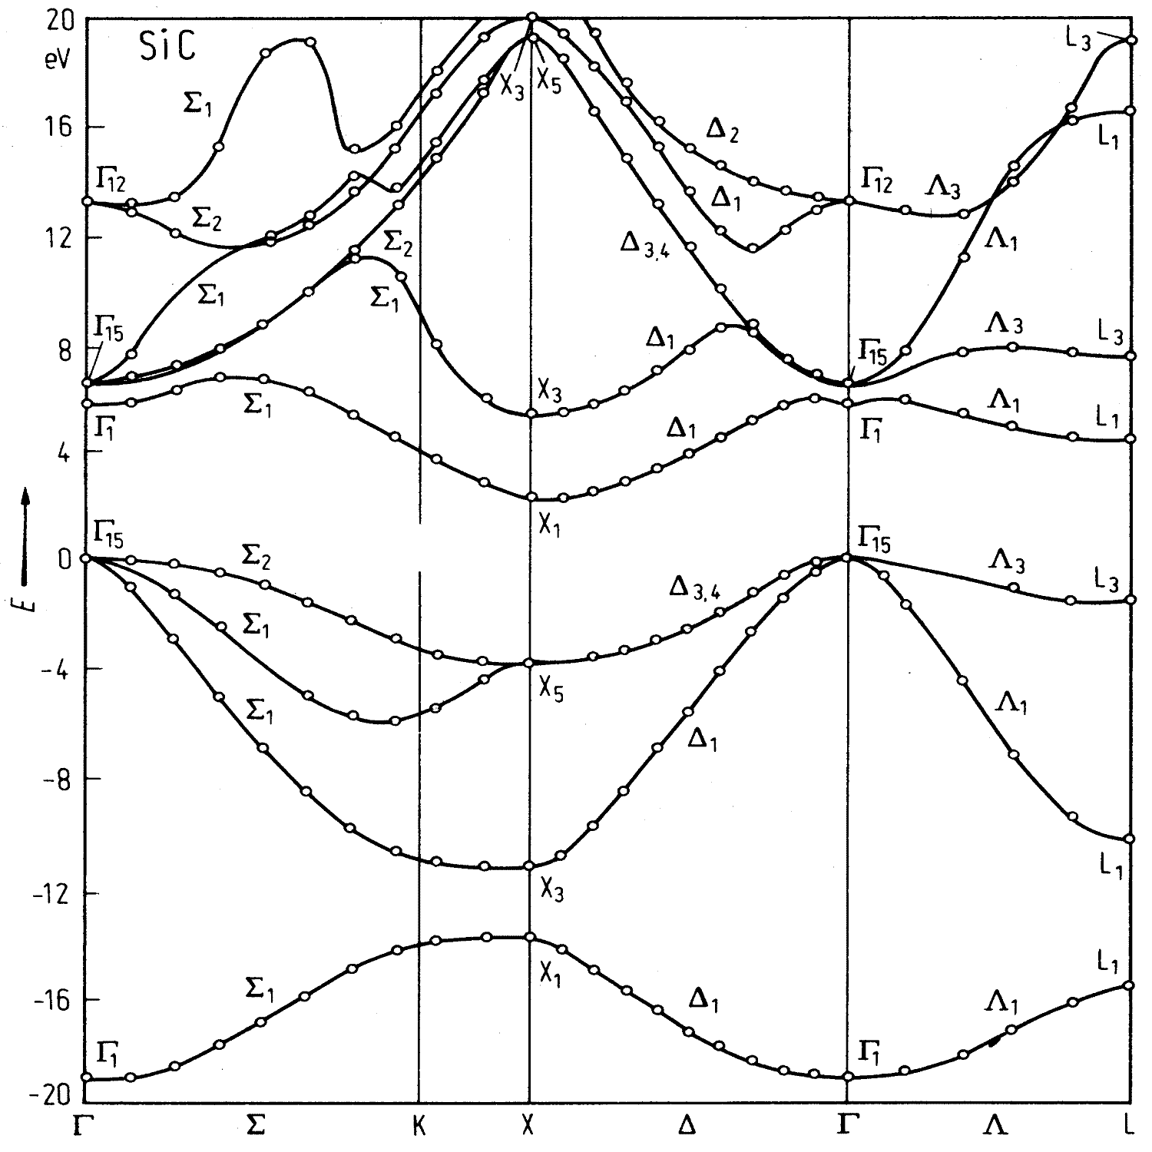
Visuals you have to explain
This is the electronic bandgap diagram for a silicon-carbide electronic system.
Welcome to my undergraduate research.

Slide 11
99%
Of the time that you are trying to make a pie chart with two slices you could instead just put a really big number on your slide and call it a day.

Slide 12
Minimize slide text.

Slide 13
No Apologizing.
Notes:
Don’t apologize for things you haven’t done or things that you ran into trouble with. Your audience has no idea what your struggles where and they a) frankly don’t care much and b) want to know what you have been able to accomplish in the time frame.

Slide 14
YOU are the presentation.
Don’t read to me.
Notes:
Don’t turn your back to the audience and read slides at us. You are the presentation and need to focus on communicating to your audience.

Slide 15
Everyone presents!
Notes:
This is an auto-fail item.

Slide 16
Fielding questions

Slide 17
What’s your scope?
Notes:
You don’t have to be a world-class expert in everything, and you don’t have to have every answer. It’s okay (and beneficial) to accept that there are some questions you can’t answer with the data and analysis you have at hand.

Slide 18
What’s your scope? II
Notes:
Don’t answer questions that you don’t have data for; e.g. if you need to speculate an answer, offer it explicitly as an opinion or speculation, and acknowledge that the question is out-of-scope.

Slide 19
What’s your scope? III: Revenge of the Sith Bad Questions.
Notes:
As an audience we often want to ask questions that can provoke a broader discussion of a topic; don’t be afraid to deflect into an after-class bar conversation.

Slide 20
Things I should know at the end of your presentation without asking:

Slide 21
Why you chose your topic.

Slide 22
What data you used to investigate with.

Slide 23
Why that data makes sense to use.

Slide 24
Your general findings.

